Slide 1

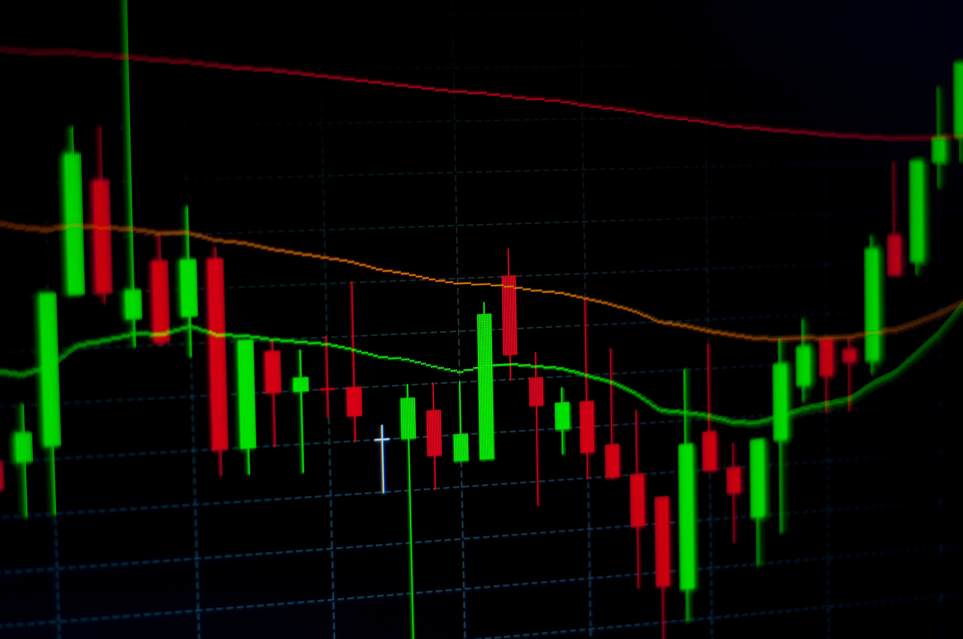
Algorithmic Trading
Visualization and Analytics of Stock Data
A069 - Harsh
A074 - Tanmay
A077 - Udit

Slide 2

02
DATASET SELECT
Yahoo Finance ; 2014 - 24
Allows us to view historical price, dividend, and split data for most quotes in Yahoo Finance to forecast the future of a company or gain market insight. Historical data is in a CSV file format to be used offline.
This data allows us to make accurate projections on current stock market prices, and since the data is from Yahoo Finance, it was upto the market standard without any major cleaning

Slide 3
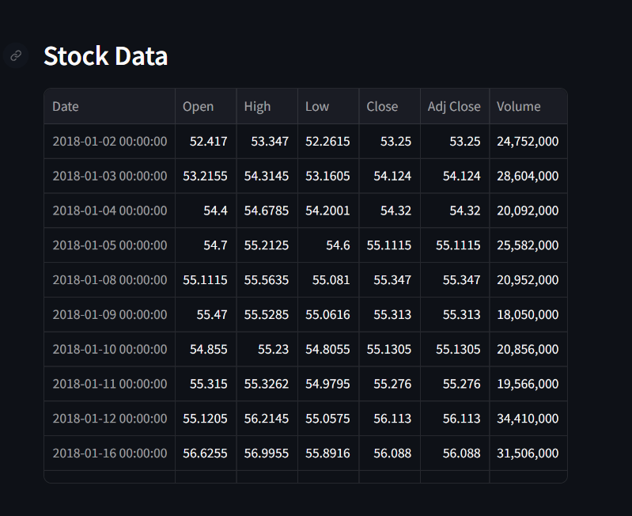

03
DATA_SET.HEAD()

Slide 4

04
TABLES CONSIDERED
DATE
OPEN
HIGH
LOW
Opening Price of the stock
Higest value
in the respective day
Lowest value
in the respective day
The date of Stock
CLOSE
ADJ CLOSE
VOLUME
Price of the Stock at closing time
Closing price considering Dividend and splits
Volume of Stock traded on that day

Slide 5


05
3 ELEMENTS OF OUR PROJECT
01
Stock Price Forecasting
Our model Utilises the data Set’s
particular stocks for selected day ‘s closing and previous 50 day’s Closing.
to Chart a normal plot.
03
02
Simple App UI
Our App is simple to understand, Clean looking with minimized visual clutter.
Stock Price Visualization
Our App allows the user to visualise the data of Stocks in Simple to understand graphs like Line graph.

Slide 6
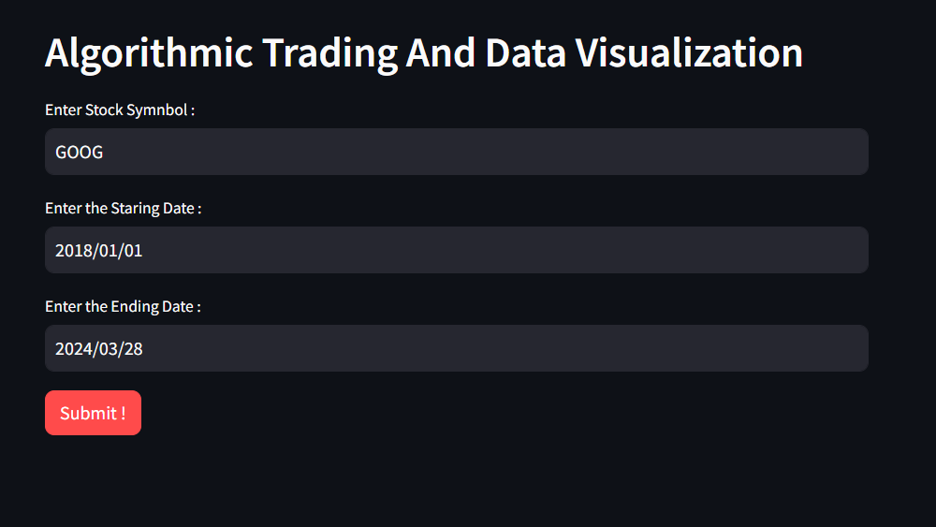
06
APPLICATION UI

Slide 7
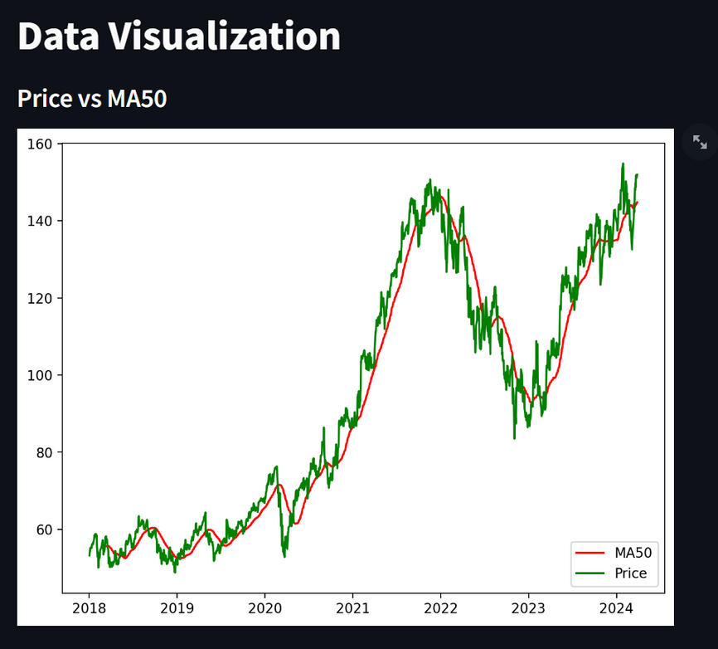
07
DATA VISUALIZATION
The 50-day moving average (MA) is a technical indicator that shows the average closing price of a stock over the previous 50 days. It's calculated by adding up the past 50 data points and dividing the result by 50. The 50-day MA is a trendline that can indicate changing price trends. Traders use it to time the placing and execution of trades.

Slide 8
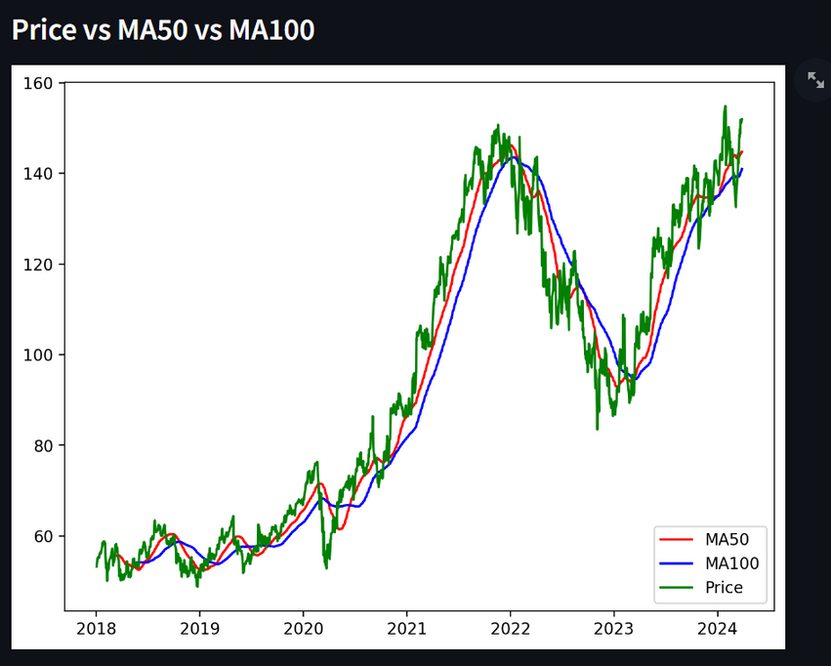
08
The 100-day moving average is a technical indicator widely used by traders. It represents the average price of a stock over a period of 100 days or medium term. Like any other moving average, the 100-day moving average also helps traders analyse price trends.

Slide 9
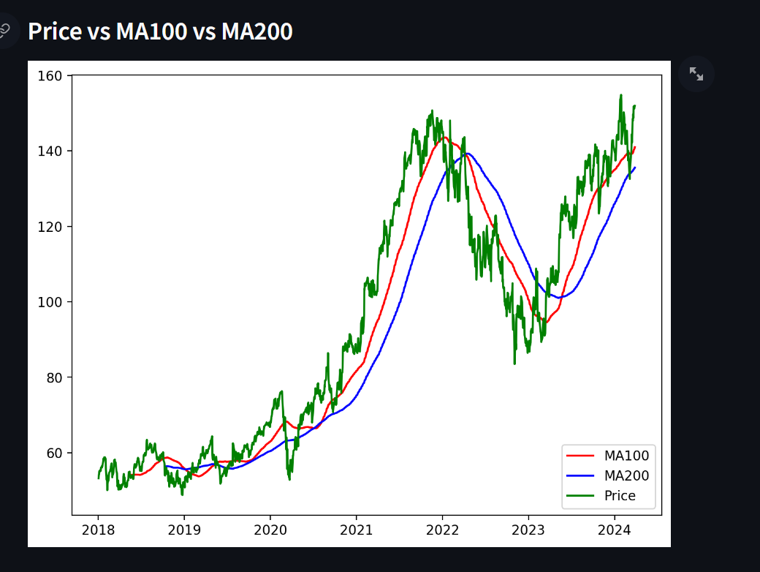
09
MA 200 refers to the 200-day moving average, which is a key indicator that shows the average closing price of a stock over the last 200 days. It is a tool that investors can use to determine when to buy or sell a stock. The 200-day moving average is represented as a line on charts, which can help traders identify potential support or resistance areas. For example, if a stock price remains above the 200-day moving average on the daily time frame, the stock is generally considered to be in an overall uptrend.

Slide 10
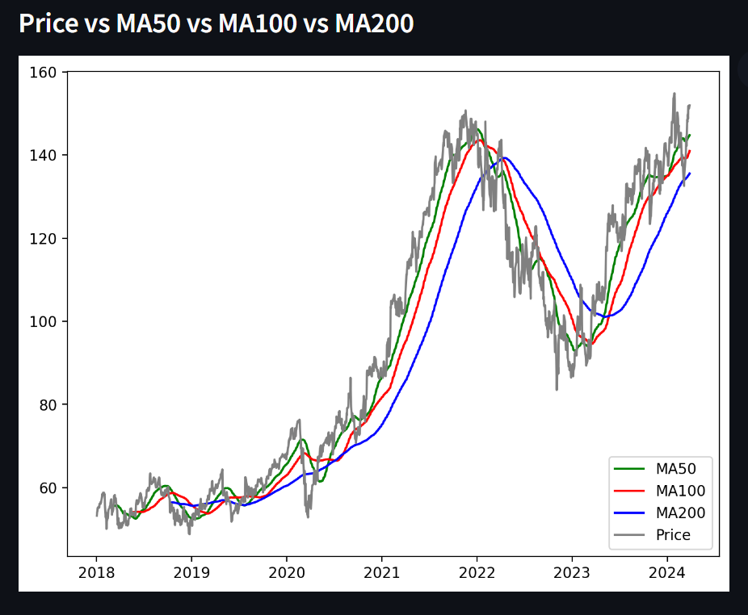
10
MA 50 | MA 100 | MA 200
The MA50 is a moving average calculated by averaging the closing prices of a security over the past 50 trading days. | The MA100 is a moving average calculated by averaging the closing prices of a security over the past 100 trading days. | The MA200 is a moving average calculated by averaging the closing prices of a security over the past 200 trading days.
It provides a short to medium-term view of the price trend. | It provides a medium-term view of the price trend, smoothing out shorter-term fluctuations more than the MA50. | It provides a longer-term view of the price trend, smoothing out short and medium-term fluctuations more significantly.

Slide 11
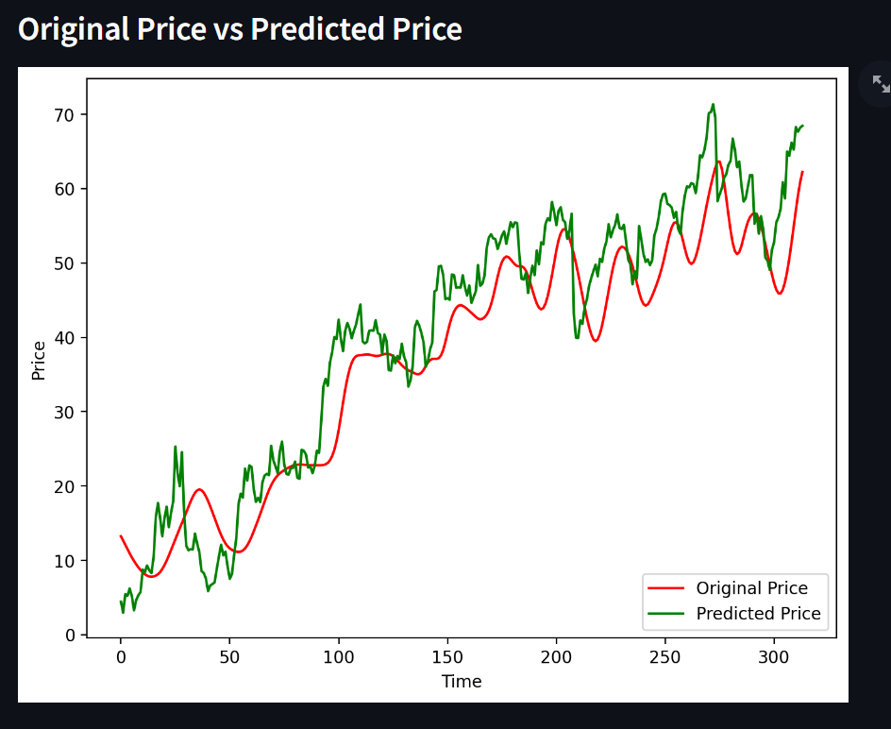
11

Slide 12
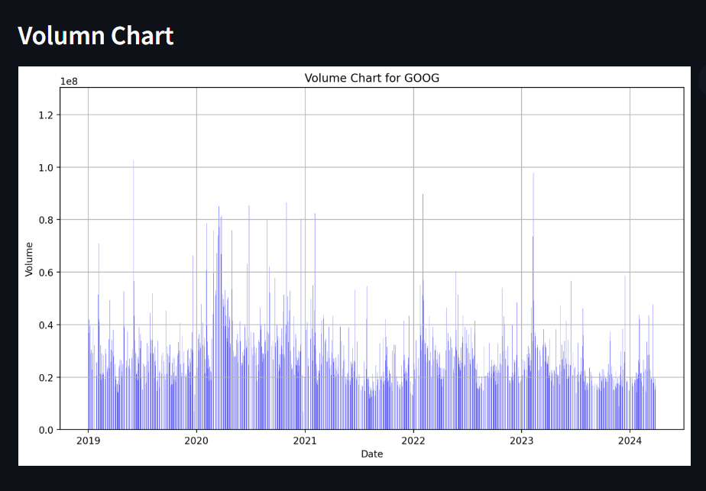
12
volume chart in financial markets displays the total amount of trading activity, typically represented in terms of the number of shares or contracts traded, over a specific period of time. Volume charts are commonly used in technical analysis alongside price charts to gain insights into market dynamics and investor behavior.

Slide 13
13
BEARISH OR BULLISH
Bullish Market: | Bearish Market:
A bullish market, also known as a bull market, is characterized by rising prices and positive investor sentiment. In a bullish market, investors are optimistic about the future prospects of the market or specific assets, leading to increased buying activity. Bull markets are typically associated with economic expansion, strong corporate earnings, low unemployment, and overall positive economic indicators. Traders and investors in a bullish market aim to buy assets with the expectation that their prices will continue to rise, allowing them to profit from future price appreciation. | A bearish market, also known as a bear market, is characterized by falling prices and negative investor sentiment. In a bearish market, investors are pessimistic about the future prospects of the market or specific assets, leading to increased selling activity. Bear markets are often associated with economic contraction, declining corporate earnings, high unemployment, and overall negative economic indicators. Traders and investors in a bearish market may adopt strategies such as short selling or holding defensive assets to protect against further losses.

Slide 14
14
CONCLUSION
In conclusion, the stock market analysis application is a powerful tool for traders and investors to make informed decisions in financial markets. By integrating various analytical tools and data sources, such an application can provide valuable insights into market trends, volatility, and potential investment opportunities. Here's a summary of the key aspects and benefits of a stock market analysis application:
Comprehensive Data Analysis:
The application offers access to a wide range of financial data, including stock prices, trading volumes, market indices, and company fundamentals.
Users can perform in-depth technical analysis, fundamental analysis, and sentiment analysis to evaluate the performance and prospects of individual stocks or the overall market.
Technical Indicators and Charting Tools:
It provides a variety of technical indicators and charting tools to identify patterns, trends, and potential entry or exit points.
Users can customize charts, apply technical indicators, and analyze historical price movements to make informed trading decisions.

Slide 15
13
REFRENCES
Dataset
Knoledge Base
Yahoo Finance
https://en.wikipedia.org/wiki/Moving_average_crossover
01
03
02
Algorithms used
MA50, MA100, MA200

Slide 16
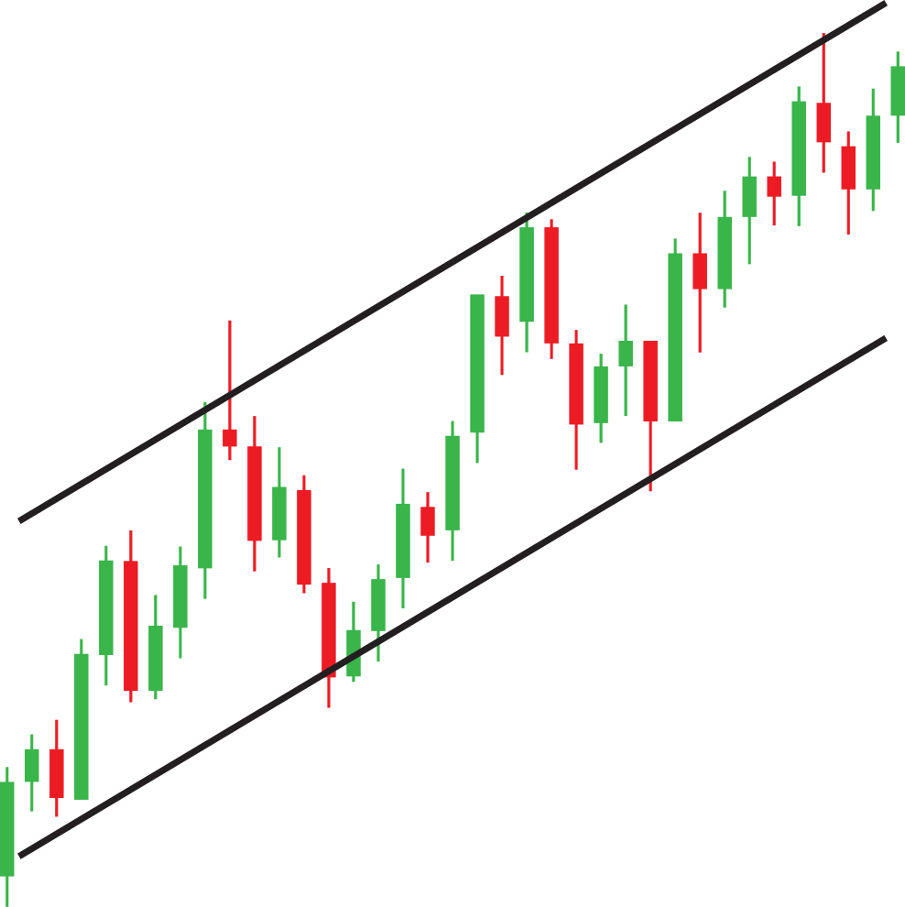
14
THANK
YOU

